Slide 1

Git Version Control

Slide 2

What is Version Control
Version Control is a system that documents changes made to a file or a set of files. It allows multiple users to manage multiple revisions of the same unit of information. It is a snapshot of your project over time.
v1. 1
v1.0
Version Control
V3.0
v2.0
v3. 1
v2.1

Slide 3

What is Version Control
Version Control is a system that
documents changes made to a file or a set of files
v1. 1
v1.0
Version
Control
It allows multiple users to manage multiple revisions of the same unit of information
v2.0
v3.
1
v2.1
V3.0
It is a snapshot of your project over time

Slide 4

Git
Git is an open source Distributed Version Control System(DVCS) which records changes made to the files laying emphasis on speed, data integrity and distributed, non-linear workflows

Slide 5
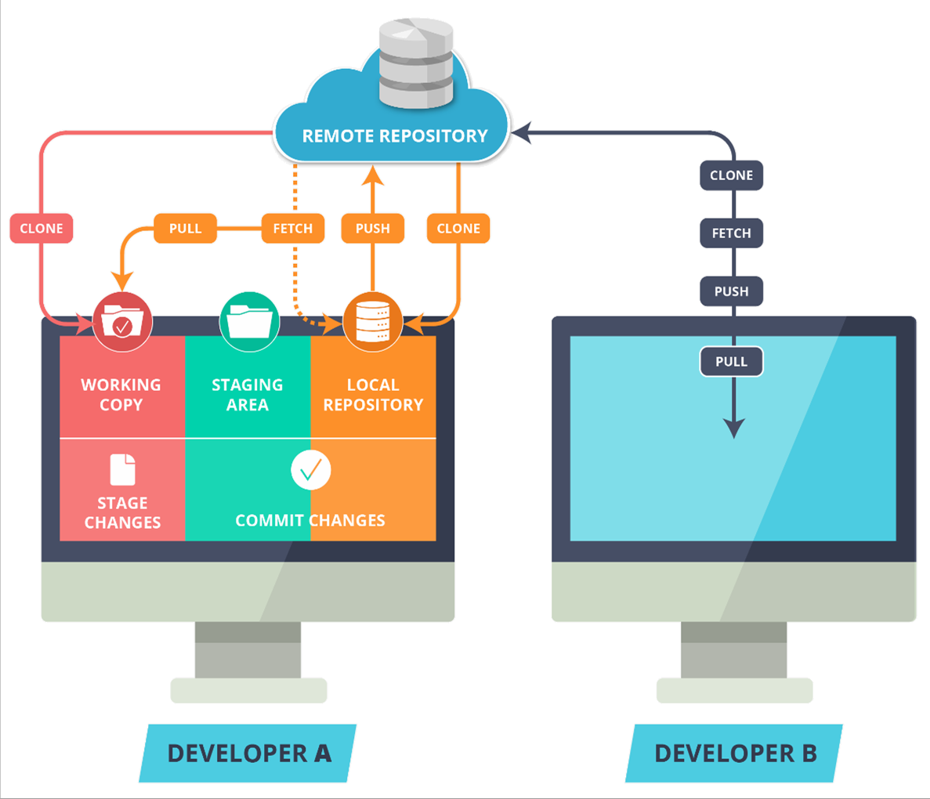
Git Workflow
Use Git workflow to manage
your project effectively
Working with set of
guidelines increases Git’s consistency and productivity

Slide 6
Git Workflow
The Remote Repository is the
server where all the collaborators upload changes made to the files

Slide 7

Git Workflow
“Local Repository” is user’s copy of the Version Database
The user accesses all the files through local repository and then push the change made to the “Remote Repository”

Slide 8

Git Workflow
“Workspace” is user’s active
directory
The user modifies existing files and creates new files in this space. Git tracks these changes compared to your Local Repository

Slide 9

Git Workflow
Stage is a place where all the modified files marked to be committed are placed.

Slide 10

Git Workflow
Clone command creates a copy of an existing Remote Repository inside the Local Repository.

Slide 11

Git Workflow
Commit command commits all the files in the staging area to the local repository.
www.cognixia.com

Slide 12

Git Workflow
Push command pushes all the changes made in the Local Repository to the Remote Repository

Slide 13

Git Workflow
Fetch command collects the changes made in the Remote repository and copies them to the Local Repository. This
command doesn’t affect our Workspace.

Slide 14

Git Workflow
Pull like Fetch, gets all the changes from the remote repository and copies them to the Local Repository
Pull merges those changes to the current working directory

Slide 15


Installing Git
To install Git on your Linux Machine you can type in the following command in
Terminal:
Syntax: sudo apt-get install git
For Windows download the installer from http://git-scm.com

Slide 16



Setting up Git User
Set up username for your repository
Syntax: git config --global user.name “username”
Set up user-email for your repository
Syntax: git config --global user.email “useremail@example.com”

Slide 17


Initialize a Git Repository
Select or create the Directory where you want to initialize Git
Initialize Git in the Directory
Syntax: git init

Slide 18




Syntax: git add <filename>
Adding Files & Checking Status
To add a file to the staging area
To check the working tree status
Syntax: git status

Slide 19


Committing Changes
To commit the staged files to you local repository:
Syntax: git commit

Slide 20


Staging & Committing Multiple Files
To stage and commit multiple files at once we use -a flag with the commit command
Commit with -a flag automatically stages all the modified files and commits changes to the local repository
Syntax: git commit -a -m ‘message’

Slide 21






Staging & Committing Multiple Files
The git rm command deletes the file from git repository as well as users system
Syntax: git rm <filename>
To remove the file from git repository but not from the system --cached option
Syntax: git rm --cached <filename>
An error shows up if you try to delete a staged file
You can force remove a staged file by using –f flag
Syntax: git rm -f <filename>

Slide 22






Git Log
The git log command shows all the commits so far on the current branch
Syntax: git log
The git log --oneline command shows only one line for all the commits so far on the
current branch
Syntax: git log --oneline
Syntax: git log –-oneline -–decorate --graph

Slide 23





Remote Repository
Mostly the users work on a local repository. But in order to collaborate with other people, we use a remote repository. A remote repository is place where the users upload and share their commits with other collaborators.

Slide 24

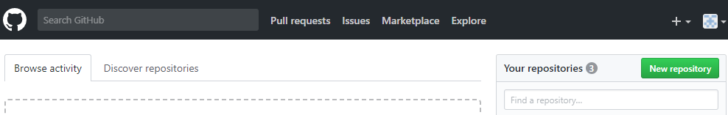



Creating a Remote Repository
Sign-up at github.com
Click on New repository to create a new repository

Slide 25

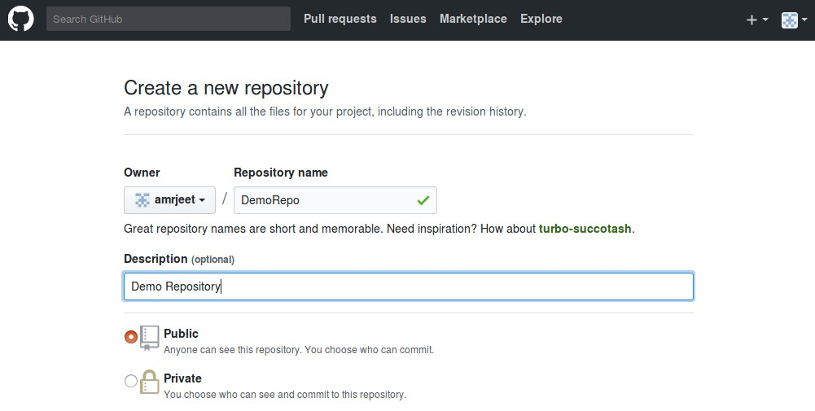
Creating a Remote Repository
Under Repository name, give a name to your repository
Give some Description about your repository under Description section.

Slide 26

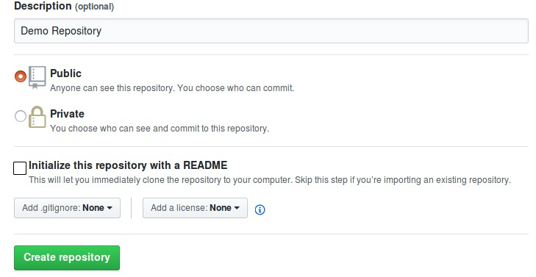
Creating a Remote Repository
For a free repository choose public
For a private repository a monthly premium needs to be paid
Finally click on Create Repository

Slide 27



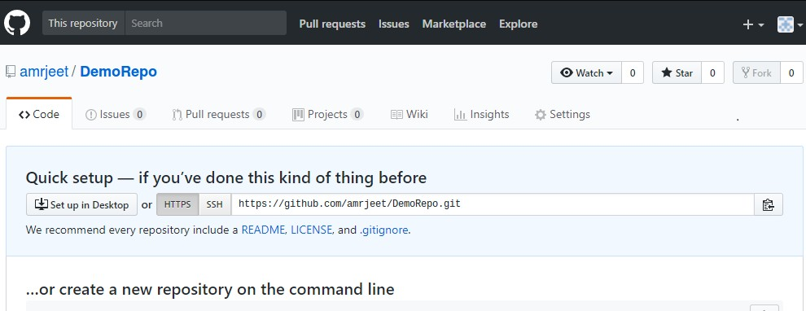


Adding Remote Repository To Local Repository
To add Remote repository to local use git add remote followed by remote link
Syntax: git add remote origin <remote link>
Remote link

Slide 28




Adding Remote Repository To Local Repository
To push Local repository to remote use push command
Syntax: git push origin master
Origin is an alias for your remote
Master is the name of the branch you are pushing from local to remote
To push other branches to remote use the following command
Syntax: git push –u origin <branch-name>

Slide 29


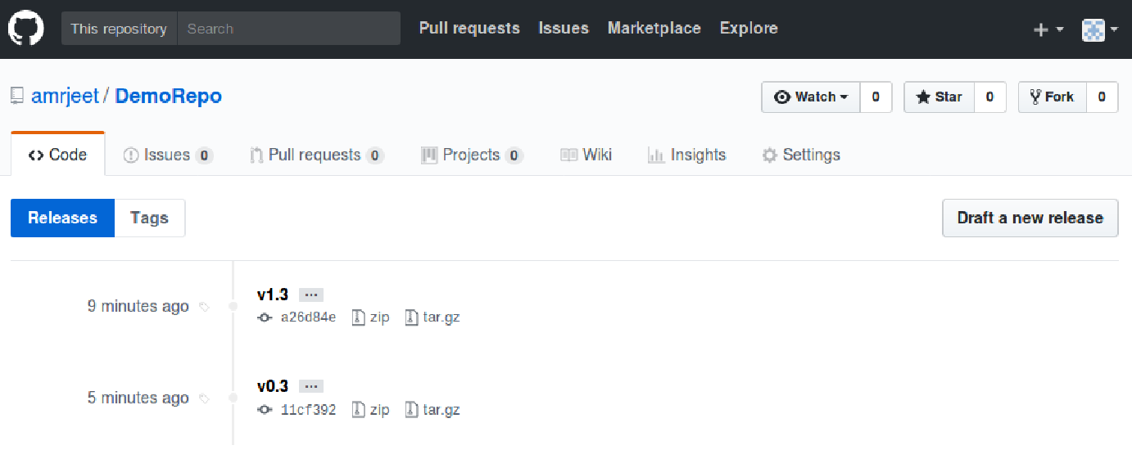
Pushing Tags to Remote Repository
Tags can be pushed, viewed and shared on Remote
Syntax: git push origin --tags
www.cognixia.com

Slide 30
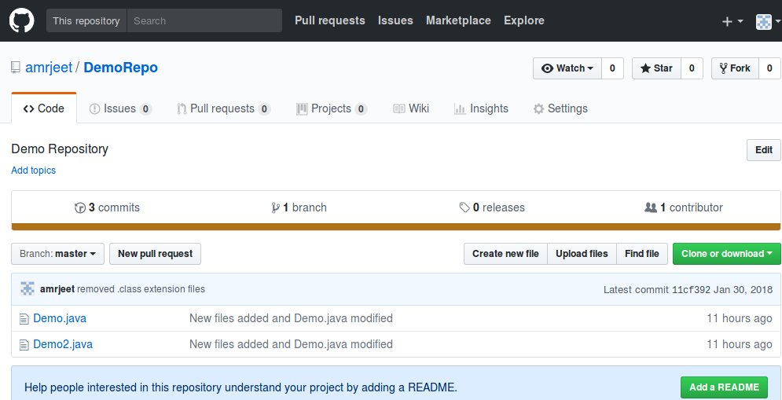
Push Local Repository To Remote
The changes can be seen in Remote repository

Slide 31

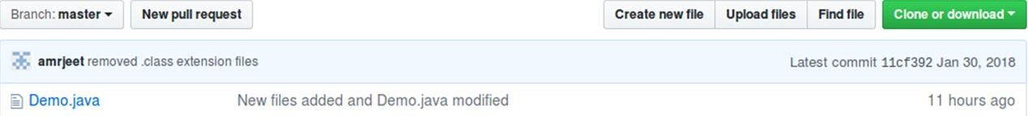

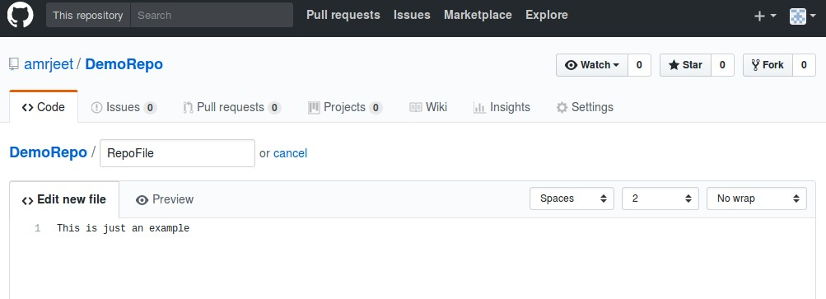
Working on Remote
Files can be created and edited on remote
www.cognixiacom

Slide 32

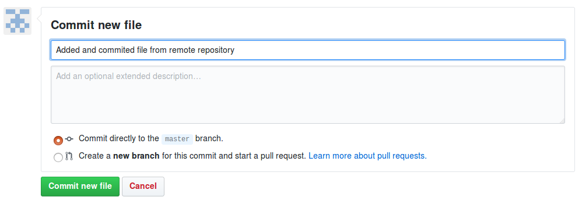




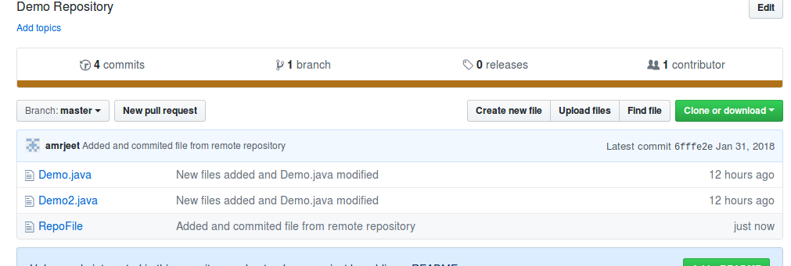
Working on Remote
These files can then be committed on the remote

Slide 33


Remote List
To list all the remotes attached to your Local repository
Syntax: git remote -v

Slide 34


Git Fetch
Fetch command copies the changes from remote to local repository
Syntax: git fetch origin
Fetch does not affect the present working directory

Slide 35


Git Pull
Pull copies all the changes from remote to local repository
It then merges the changes with the present working directory
Syntax: git pull origin

Slide 36

Git Branches
A project in its development could take multiple different paths to achieve its goal.
Branching helps us take these different directions, test them out and in the end
achieve the required goal.

Slide 37
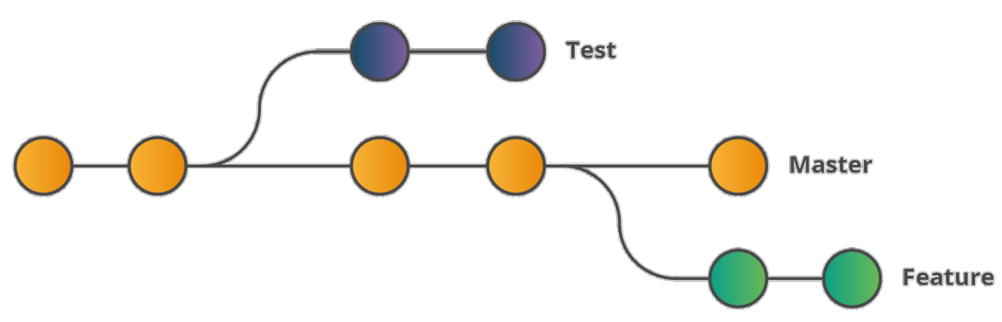
Branching in Git
Branching is an integral part of any Version Control(VC) System
Unlike other VC’s Git does not create a copy of existing files for new branch
It points to snapshot of the changes you have made in the system

Slide 38




Syntax: git branch <branchname>
Creating a Branch
To create a new branch from your current branch
You can then switch to this newly created branch
Syntax: git checkout <branchname>

Slide 39




Creating a Branch
Creating and switching to a new branch can be done with using -b flag
Syntax: git checkout -b <branchname>
Branch command lists all the branches and also points to the current working branch
Syntax: git branch

Slide 40

Merging in Git
Merging integrates the changes made in different branches into one single
branch

Slide 41


Merging in Git
Different modified branches can be merged together using merge
Syntax: git merge <branchname>
The branch mentioned is merged into the current branch

Slide 42
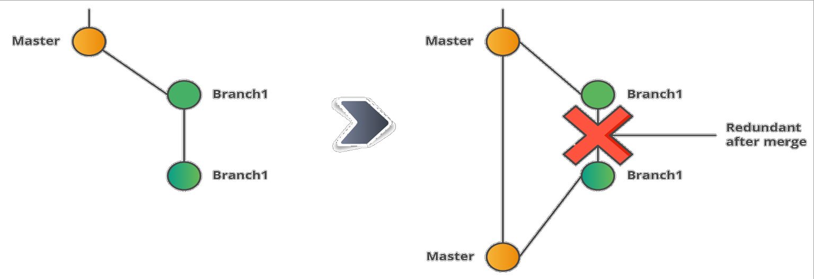
Merging in Git
All the changes made in Branch1 after merging are available in the Merged
branch(Master)
Branch1 becomes redundant after merging, hence it can be deleted

Slide 43




Syntax: git branch -d <branchname>
Deleting a Branch
Merged branches can be deleted using -d flag
Unmerged branches can be deleted using -D flag
Syntax: git branch -D <branchname>

Slide 44

Merge Conflicts
Merge conflicts arise when two files having same content modified are merged
Merge conflicts can occur on merging branches or when merging forked history
together
CODE
abcd efgh Ijkl mnop
CODE
abcd efgh WXYZ
mnop
CODE
abcd efgh QRST
mnop

Slide 45
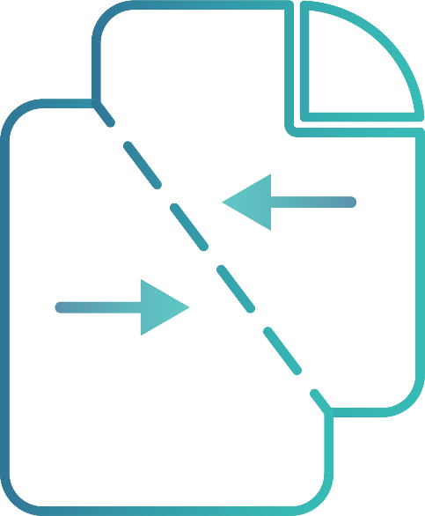
Resolving Merge Conflicts
Merge Conflicts are resolved manually by users
Git provides different Merge-Tools to compare and choose the required changes
User can also use third party Merge-Tools with Git

Slide 46












Initial RepoFile in Master Branch
Merge Conflicts
Modified RepoFile in Master Branch
Modified RepoFile in Feature1
www^{B}.c^{r}oªg^{n}ni^{c}x^{h}ia.com

Slide 47
Resolving Merge Conflicts
Merge Conflict arises on merging branches
Set a default merge tool before resolving conflict
Commit the resolved changes
Merge the branch again

Slide 48


Git Stashing
Git Stashing is a way of creating a checkpoint for non- committed changes. It saves all the changes to a temporary location so the user can perform other tasks such as switching branches, reverting etc. These changes can then be reapplied anywhere.

Slide 49




Syntax: git stash save ‘message’
Git Stashing
To Create a stash of your current working directory
To list all the saved stashes
Syntax: git stash list
Stash list uses a stack structure to save the list

Slide 50


Syntax: git stash apply <stash id>
Applying a Stash
Saved stashes can be applied at anytime on any branch
After applying a stash it can still be accessed elsewhere because
it remains in the stash

Slide 51




Syntax: git stash drop <stack id>
Deleting Stashes
Stashes can be deleted from the stash list
The entire stack can also be deleted using one command
Syntax: git stash clear

Slide 52


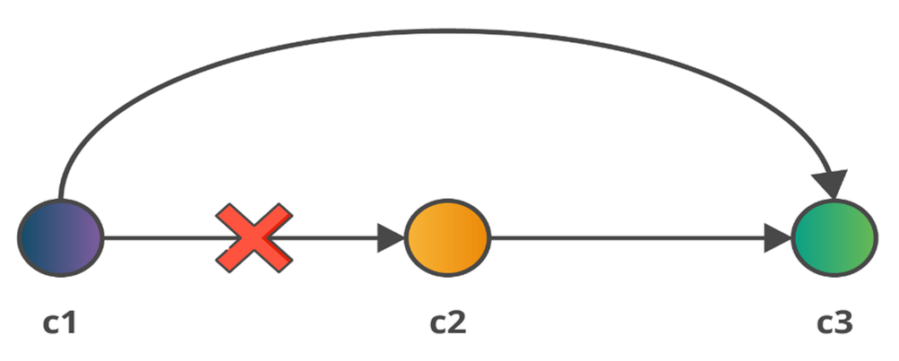
Git Revert
Revert or undo the changes made in the previous commit
New commit is created without the changes made in the other
commit
Syntax: git revert <commit id>
Old commit still resides in the history

Slide 53
THANK YOU

